Slide 1

Parallel & Distributed Computing Lecture NO: 01 Introduction
Farhad M. Riaz
Farhad.Muhammad@numl.edu.pk
Department of Computer Science
NUML, Islamabad

Slide 2
Course Pre-requisites
Programming Experience (preferably Python/C++/Java)
Understanding of Computer Organization and Architecture
Understanding of Operating System

Slide 3
Requirements & Grading
Roughly
50 % Final Exam
25% Internal Evaluation
Quiz 8 Marks
Assignments 8 Marks
Project 9 Marks
25% Mid term exam

Slide 4

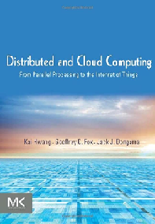


Books
Some good books are:
Distributed Systems Third edition
PRINCIPLES OF PARALLEL PROGRAMMING
Designing and Building Parallel Programs
Distributed and Cloud Computing

Slide 5
Course Project
At the end of the semester students needs to submit a semester project like
Distributed computing & smart city services
Large scale convolutional neural networks
Distributed computing with delay tolerant network

Slide 6
Course Overview
This course covers following main concepts
Concepts of parallel and distributed computing
Analysis and profiling of applications
Shared memory concepts
Distributed memory concepts
Parallel and distributed programming (OpenMP, MPI)
GPU based computing and programming (CUDA)
Virtualization
Cloud Computing, MapReduce
Grid Computing
Peer-to-Peer Computing
Future trends in computing

Slide 7
Recommended Material
Distributed Systems, Maarten van Steen & Andrew S. Tanenbaum, 3rd Edition (2020), Pearson.
Parallel Programming: Concepts and Practice, Bertil Schmidt, Jorge Gonzalez-Dominguez, Christian Hundt, Moritz Schlarb, 1st Edition (2018), Elsevier.
Parallel and High-Performance Computing, Robert Robey and Yuliana Zamora, 1st Edition (2021).
Distributed and Cloud Computing: From Parallel Processing to the Internet of Things, Kai Hwang, Jack Dongarra, Geoffrey Fox, 1st Edition (2012), Elsevier.
Multicore and GPU Programming: An Integrated Approach, Gerassimos Barlas, 2nd Edition (2015), Elsevier.
Parallel programming: For multicore and cluster systems. Rauber, Thomas, and Gudula Rünger. Springer Science & Business Media, 2013.

Slide 8

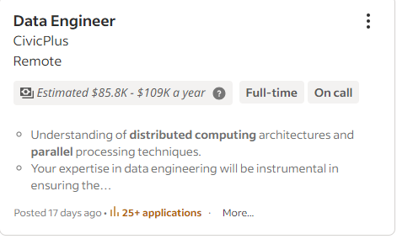
Recent Jobs

Slide 9
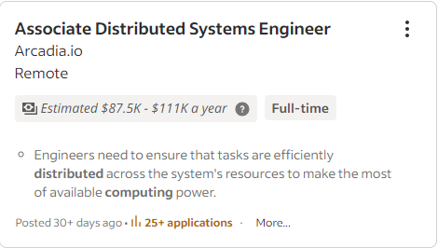
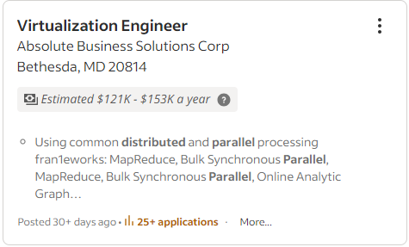
Jobs

Slide 10
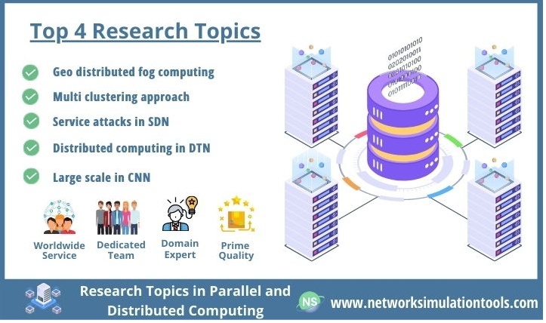
Research In Parallel & Distributed Computing

Slide 11
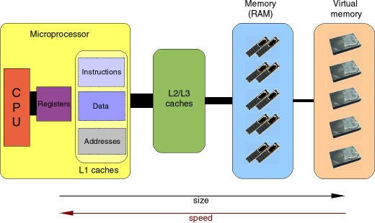
Single Processor Architecture

Slide 12
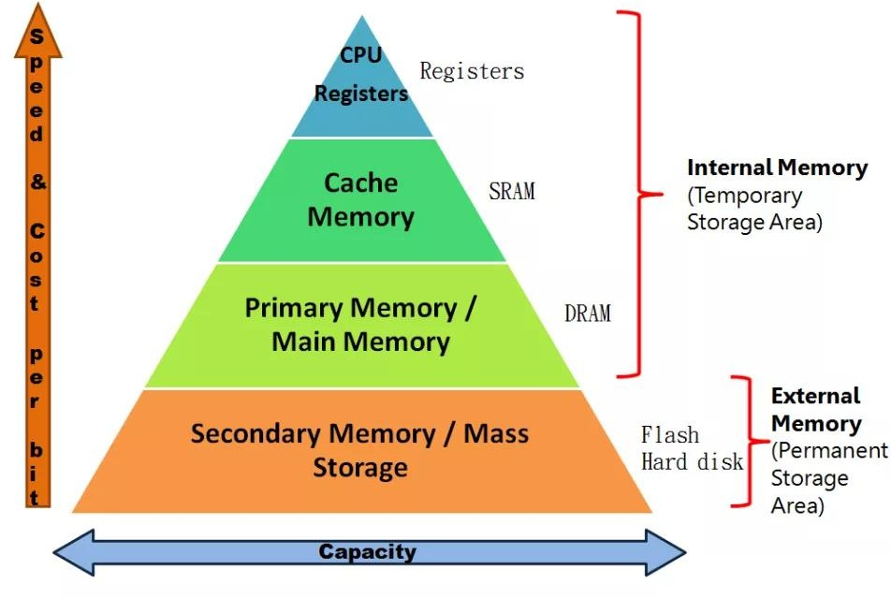
Memory Hierarchy

Slide 13
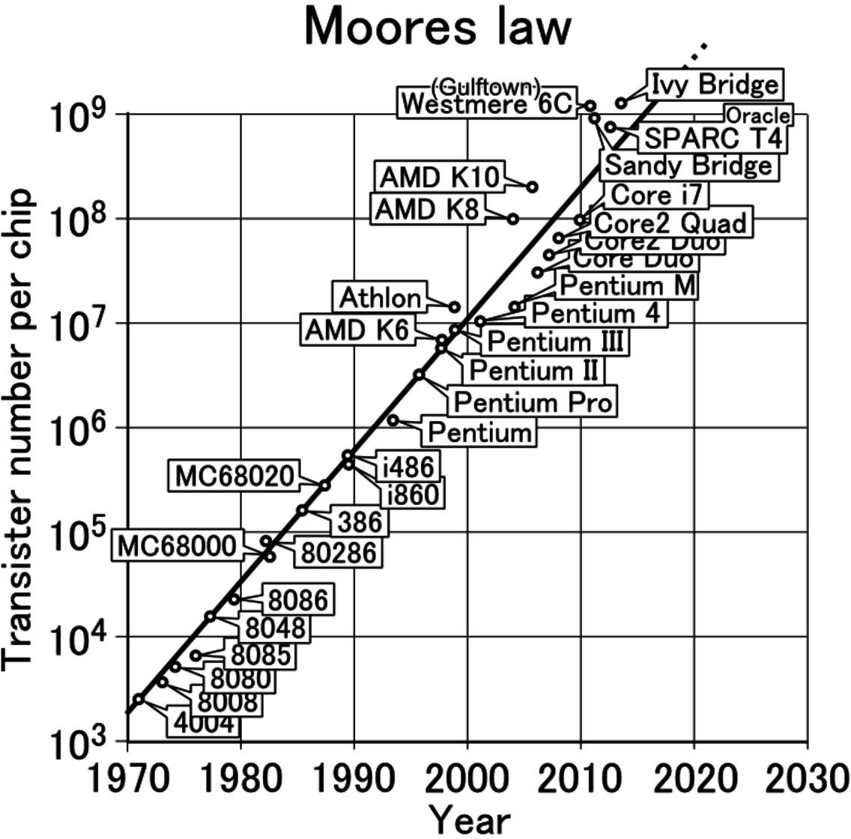

Slide 14
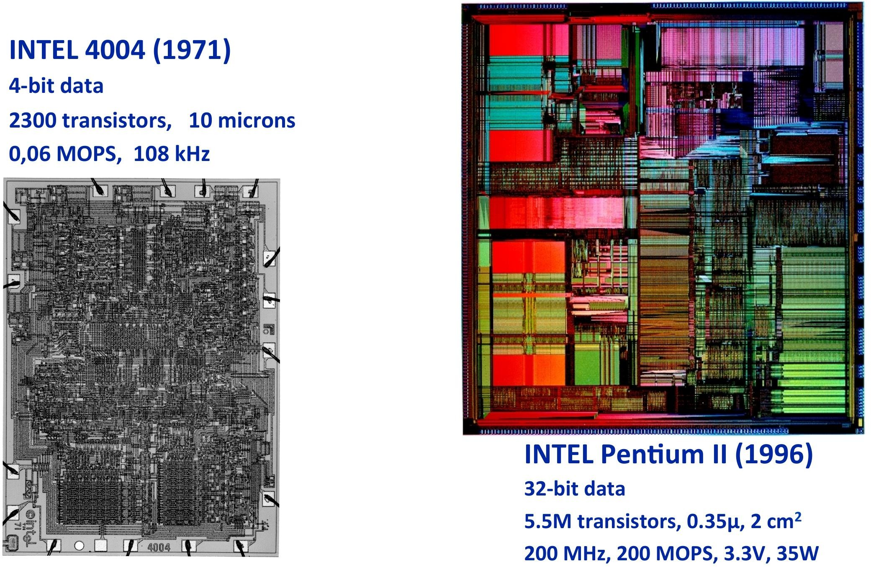
5 years of Technology Advance

Slide 15
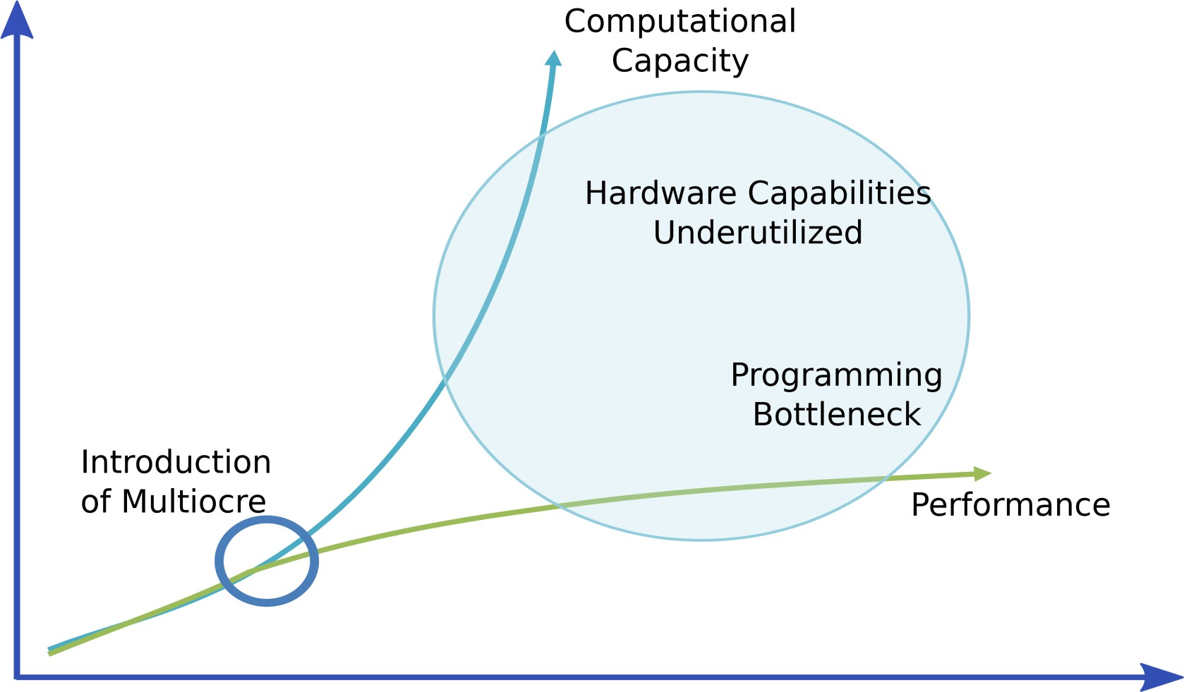
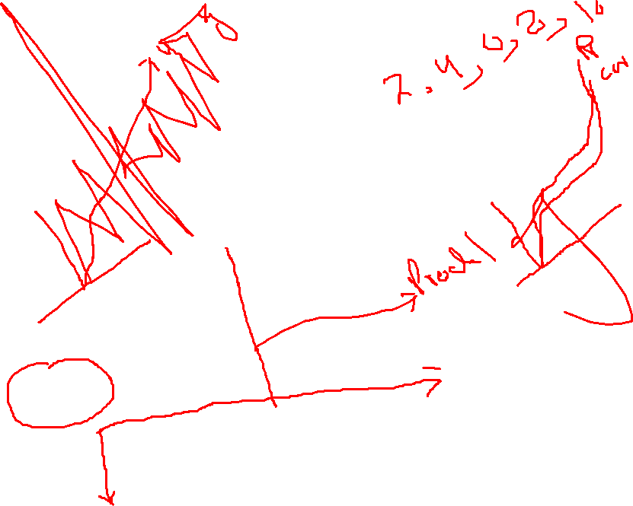
Productivity Gap

Slide 16
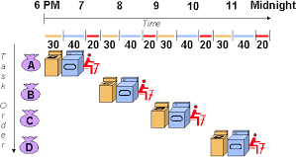
Pipelining

Slide 17
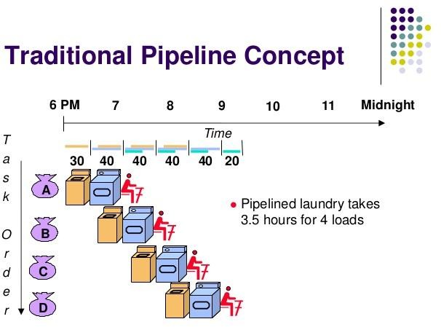
Pipelining

Slide 18
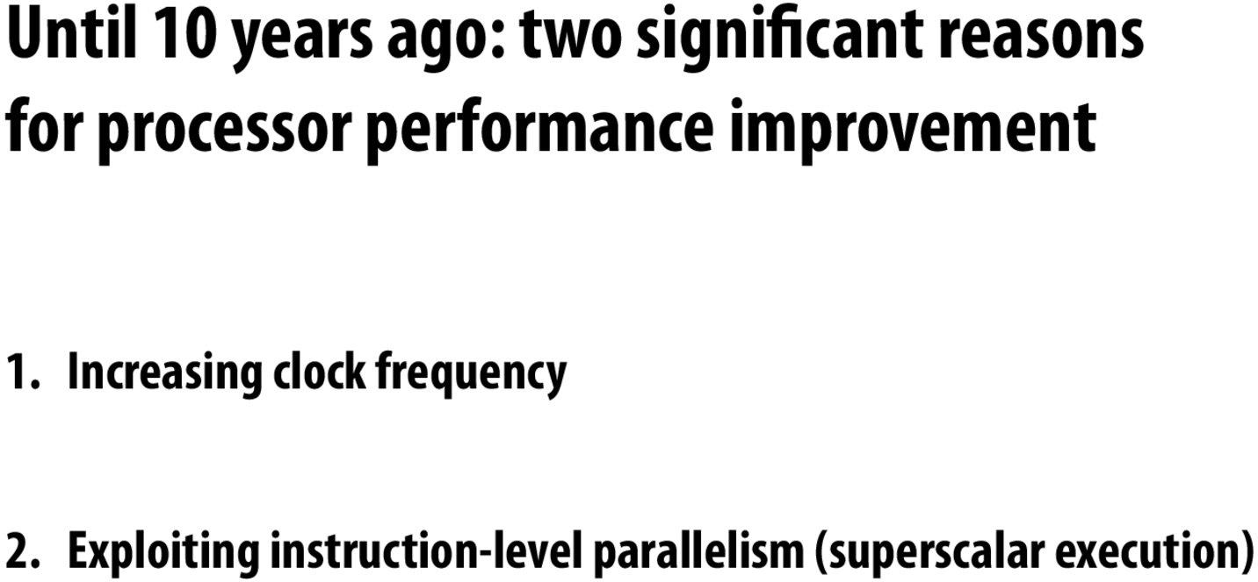

Slide 19
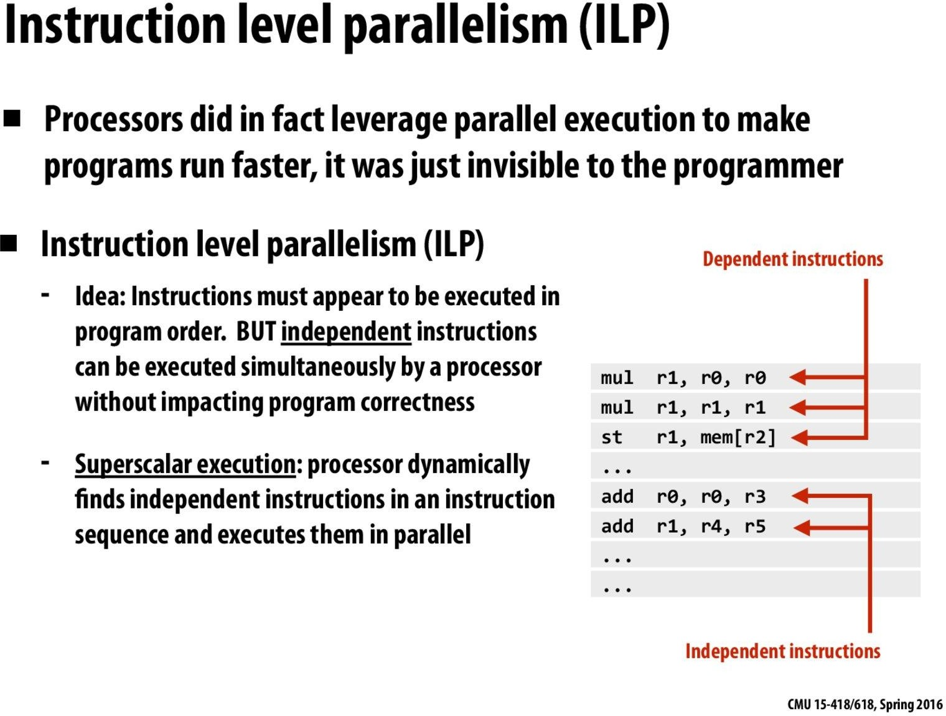

Slide 20
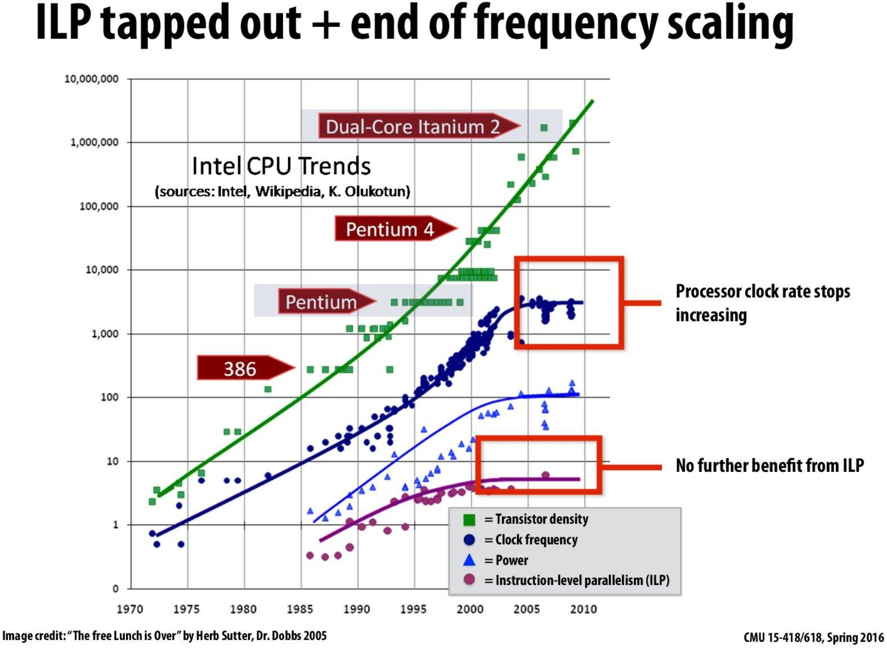

Slide 21
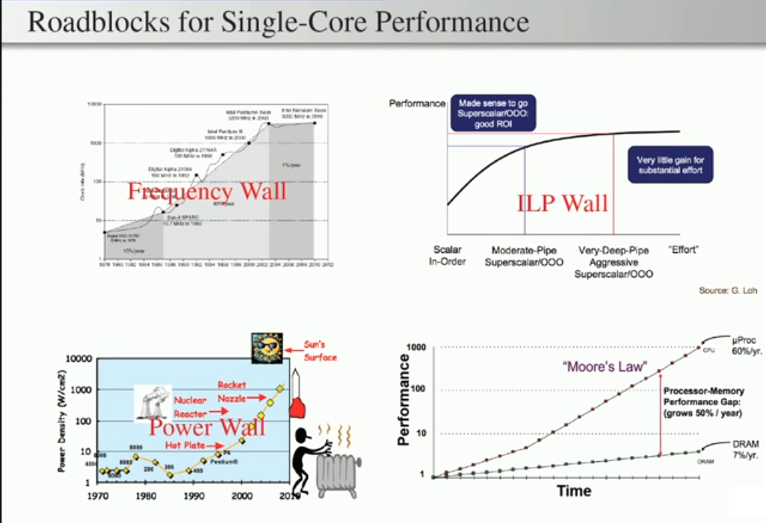

Slide 22
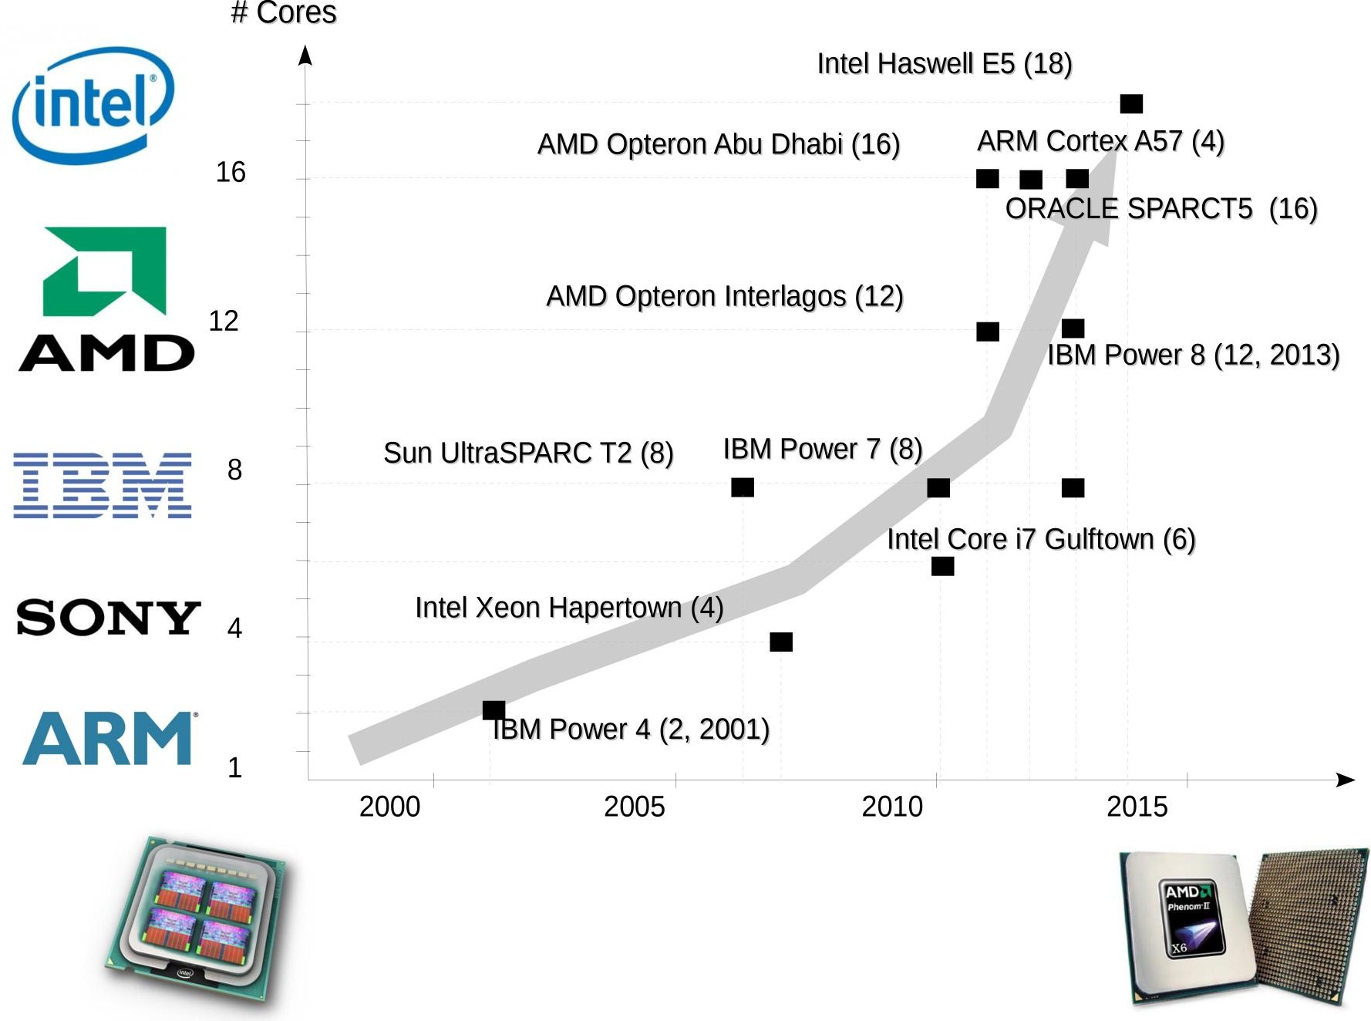
Multicore Trend

Slide 23
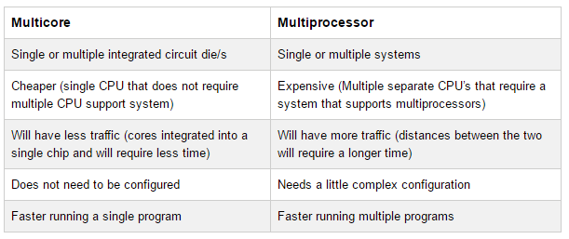

Slide 24
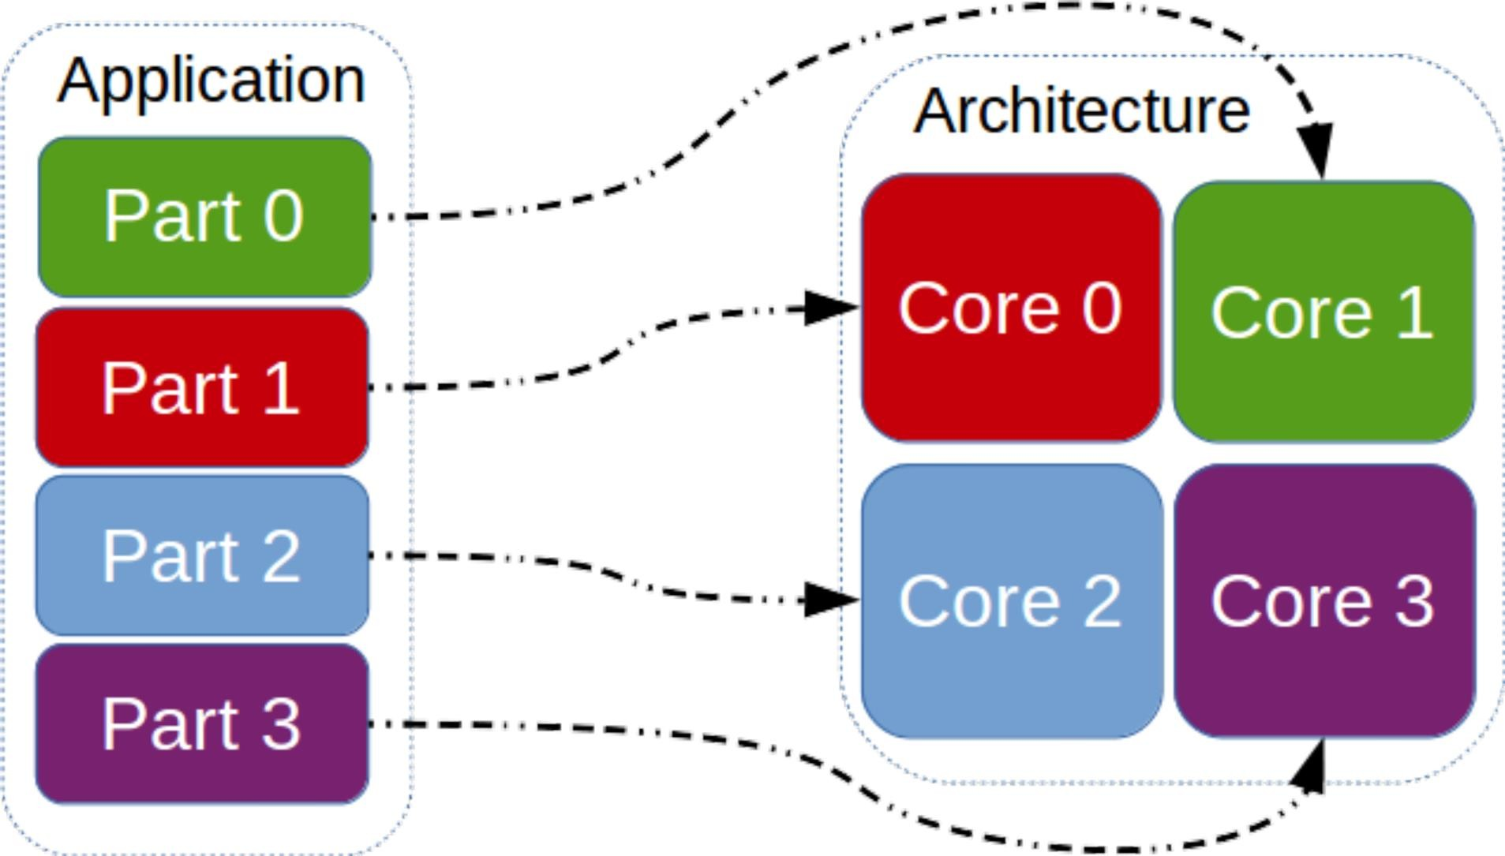
Application Partitioning

Slide 25
High-Performance Computing (HPC)
HPC is the use of parallel processing for running advanced application programs efficiently, reliably and quickly.
It applies especially to systems that function above a tera FLOPs (floating-point operations per second) processing speed.
The term HPC is occasionally used as a synonym for supercomputing, although technically a supercomputer is a system that performs at or near the currently highest operational rate for computers.

Slide 26
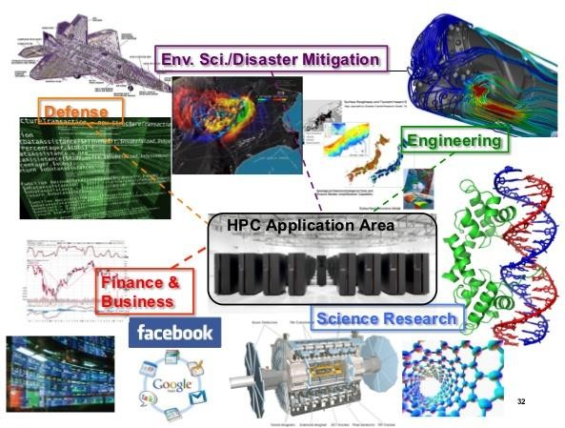
High Performance Computing

Slide 27
GPU-accelerated Computing
GPU-accelerated computing is the use of a graphics processing unit (GPU) together with a CPU to accelerate deep learning, analytics, and engineering applications.
Pioneered in 2007 by NVIDIA, GPU accelerators now power energy-efficient data centers in government labs, universities, enterprises, and small-and-medium businesses around the world.
They play a huge role in accelerating applications in platforms ranging from artificial intelligence to cars, drones, and robots.

Slide 28
What is GPU?
It is a processor optimized for 2D/3D graphics, video, visual computing, and display.
It is highly parallel, highly multithreaded multiprocessor optimized for visual computing.
It provide real-time visual interaction with computed objects via graphics images, and video.
It serves as both a programmable graphics processor and a scalable parallel computing platform.
Heterogeneous Systems: combine a GPU with a CPU

Slide 29
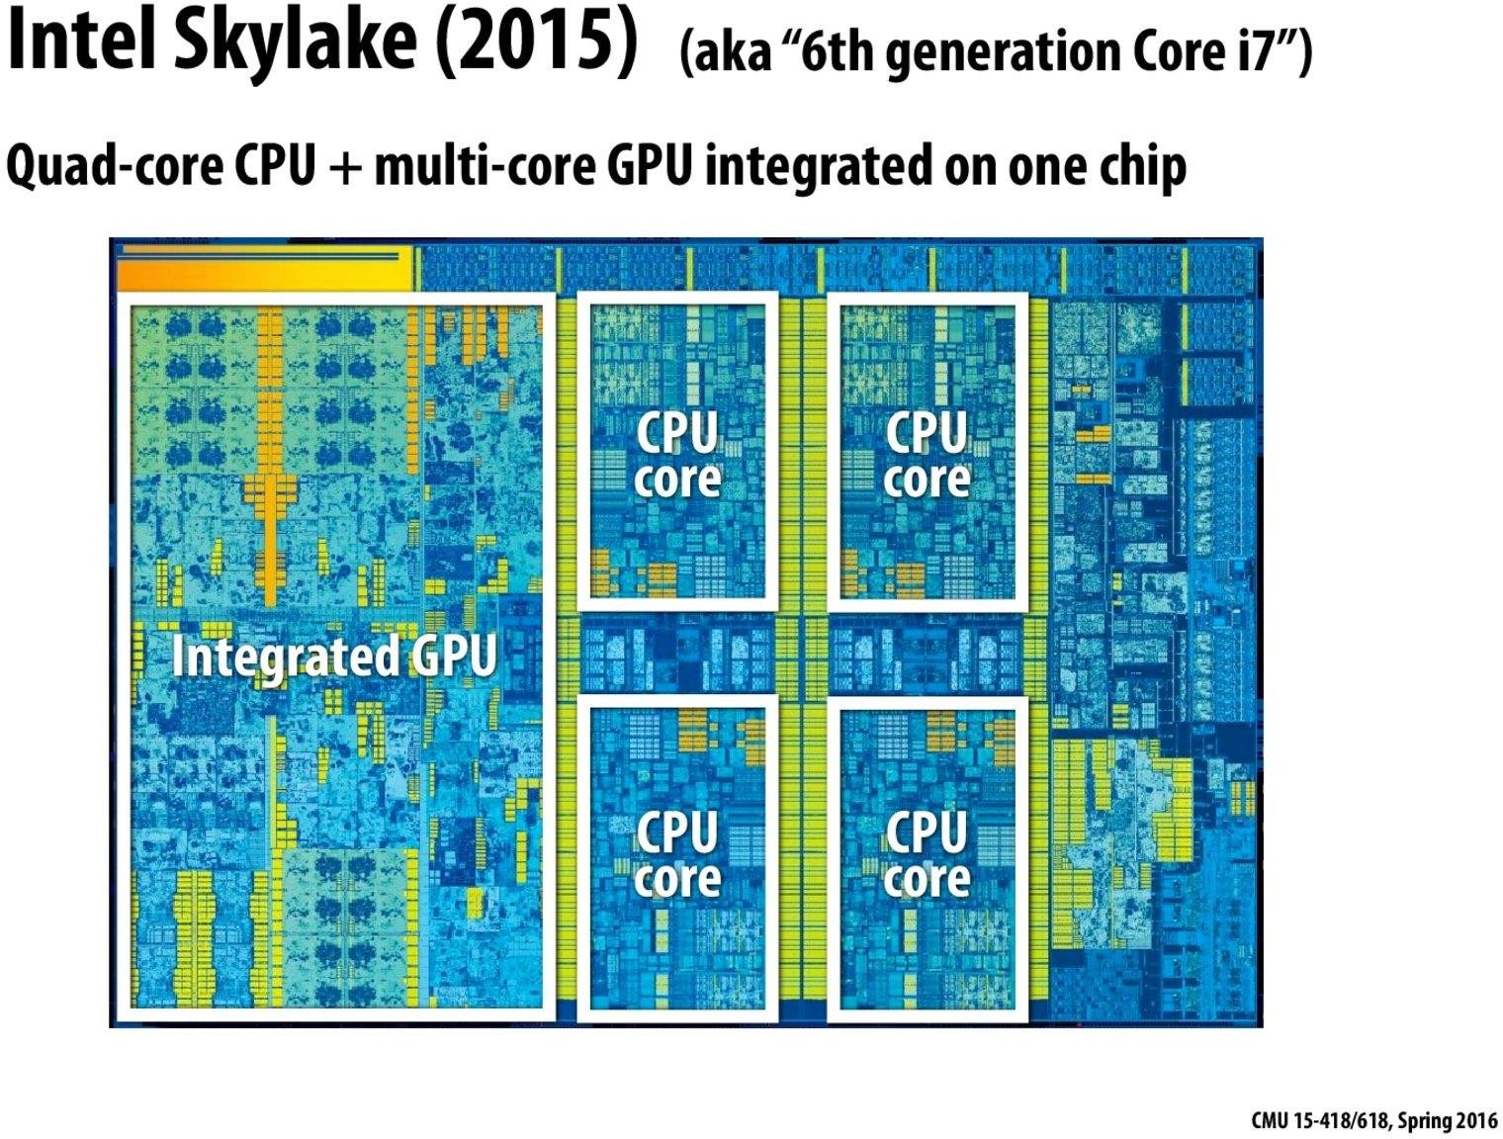

Slide 30
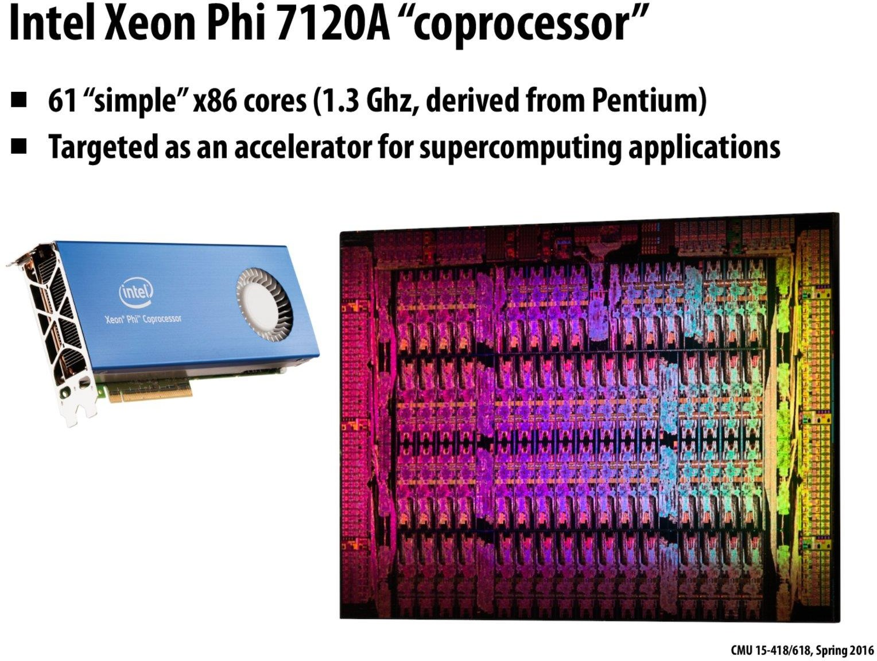

Slide 31
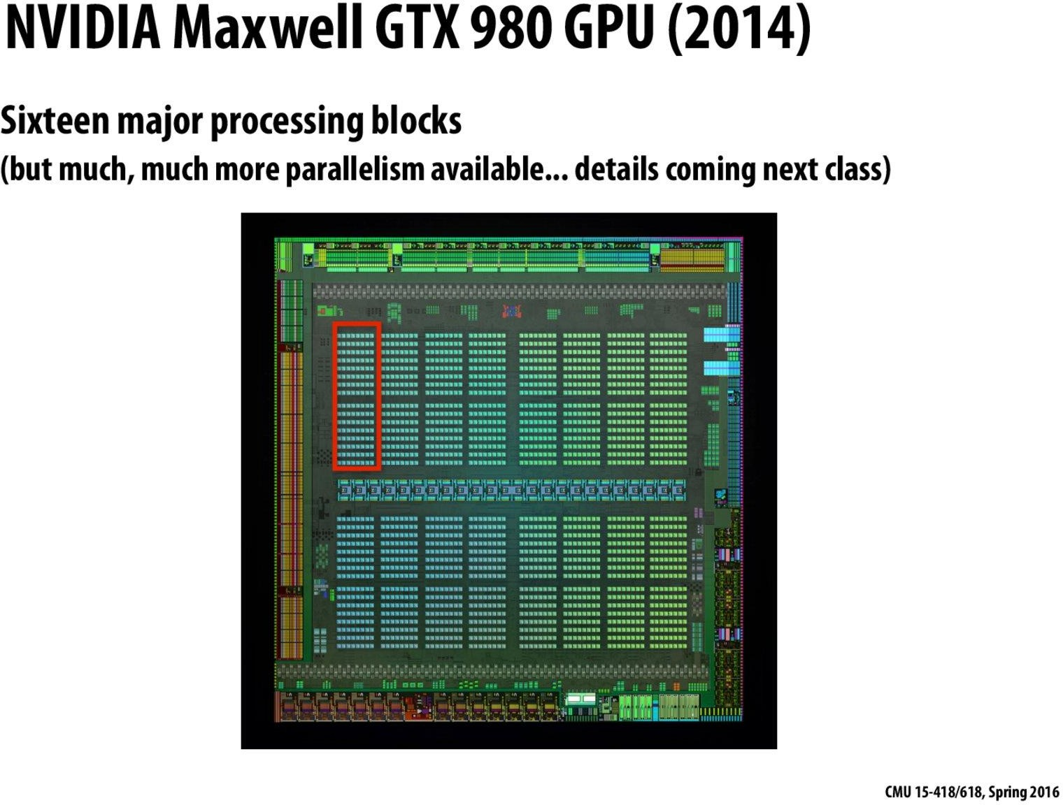


Slide 32
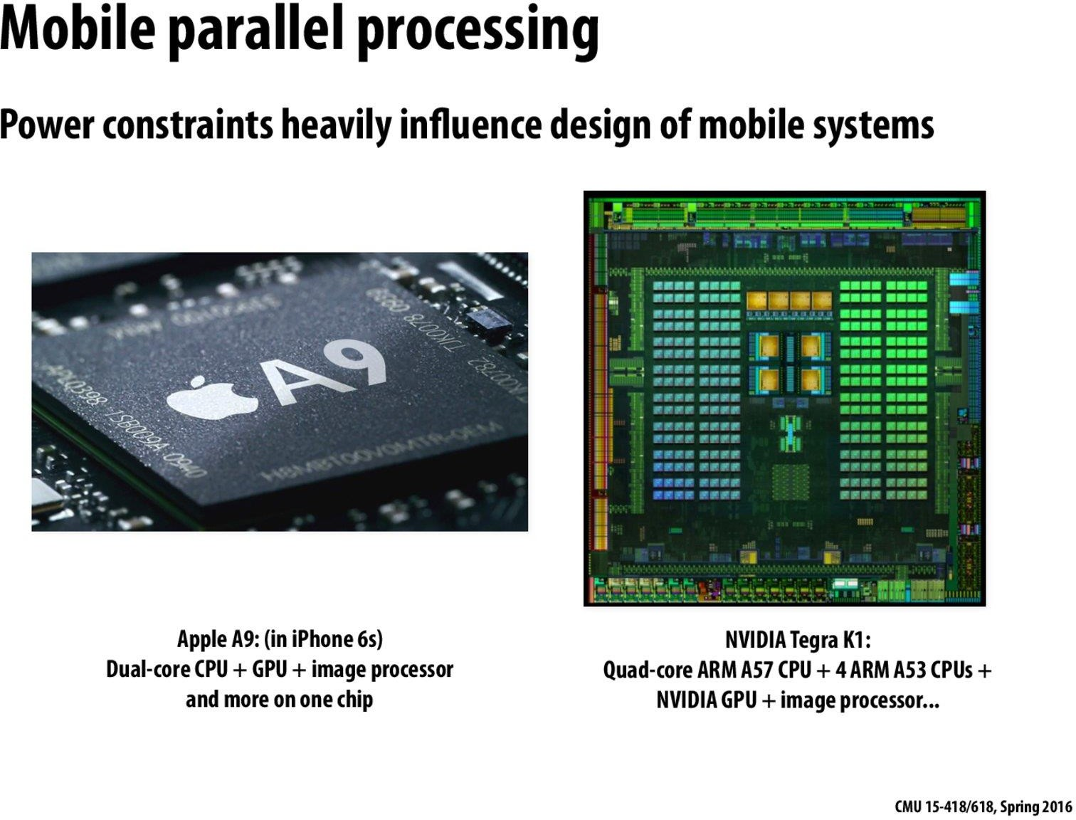

Slide 33
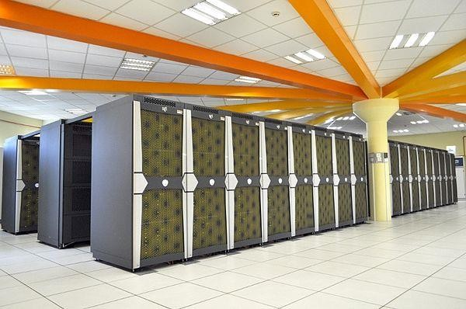
SGI Altix Supercomputer 2300 processors

Slide 34
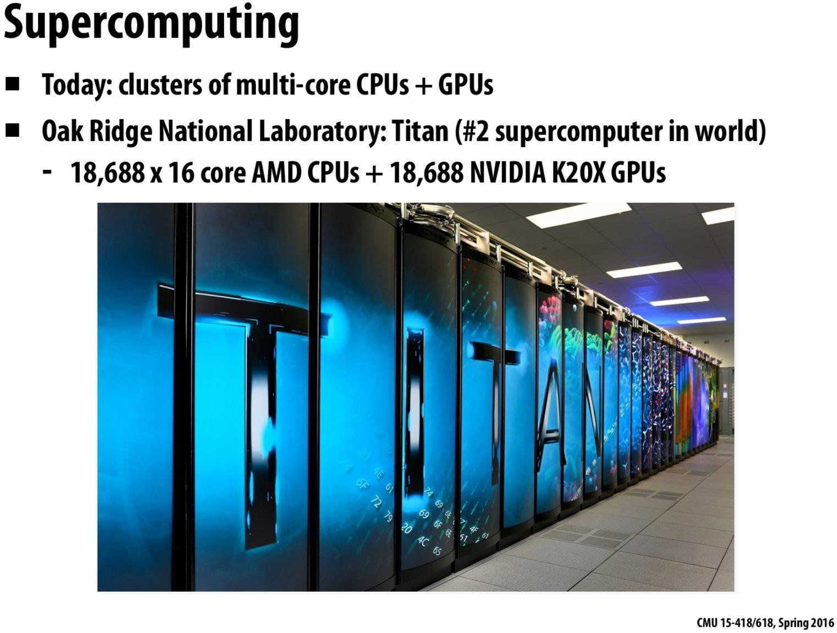

Slide 35
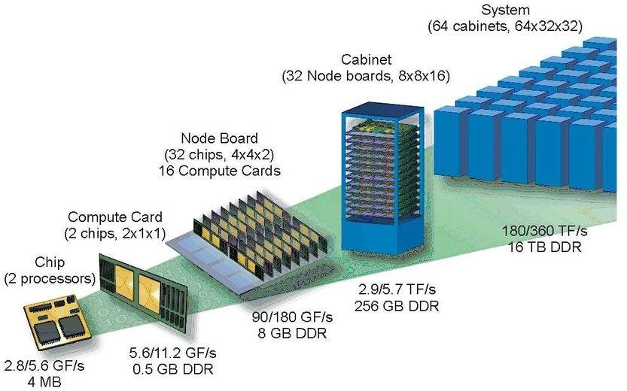
HPC System composition

Slide 36
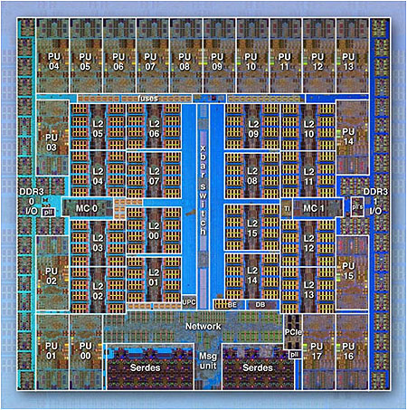
Parallel Computers
Virtually all stand-alone computers today are parallel from hardware perspective:
Multiple functional units (L1 cache, L2 cache, branch, pre-fetch, decode, floating-point, graphics processing (GPU), integer, etc.)
Multiple execution units/cores
Multiple hardware threads
IBM BG/Q Compute Chip with 18 cores (PU) and 16 L2 Cache units (L2)

Slide 37
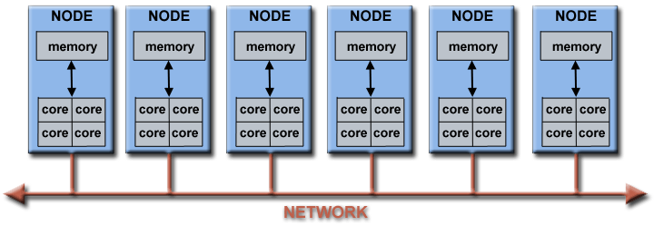
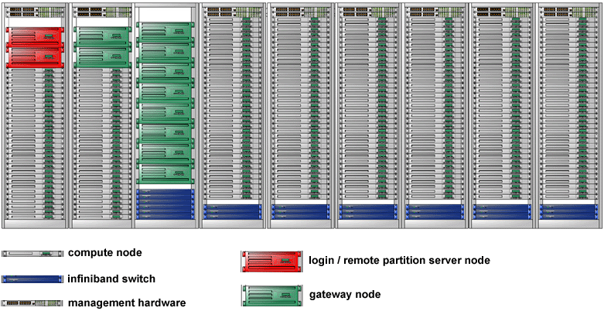
Parallel Computers
Networks connect multiple stand-alone computers (nodes) to make larger parallel computer clusters.
Parallel computer cluster
Each compute node is a multi-processor parallel computer in itself
Multiple compute nodes are networked together with an Infiniband network
Special purpose nodes, also multi-processor, are used for other purposes

Slide 38
Types of Parallel and Distributed Computing
Parallel Computing
Shared Memory
Distributed Memory
Distributed Computing
Cluster Computing
Grid Computing
Cloud Computing
Distributed Pervasive Systems

Slide 39
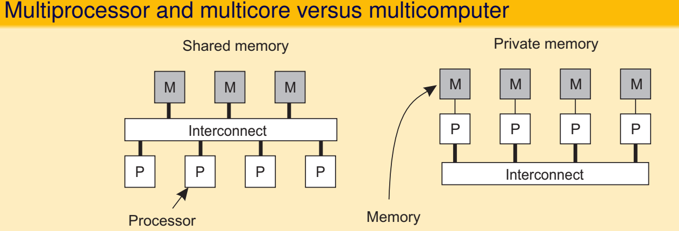

Parallel Computing

Slide 40
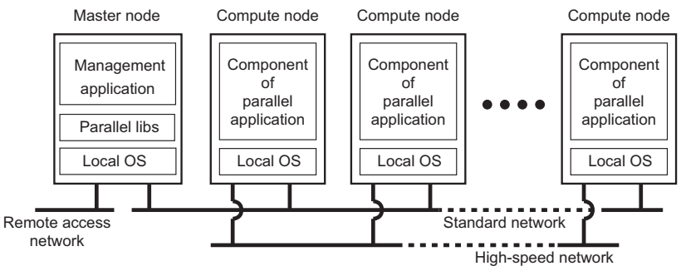
Distributed (Cluster) Computing
Essentially a group of high-end systems connected through a LAN
Homogeneous: same OS, near-identical hardware
Single managing node

Slide 41
Distributed (Grid) Computing
Lots of nodes from everywhere
Heterogeneous
Dispersed across several organizations
Can easily span a wide-area network
To allow for collaborations, grids generally use virtual organizations.
In essence, this is a grouping of users (or their IDs) that will allow for authorization on resource allocation.

Slide 42
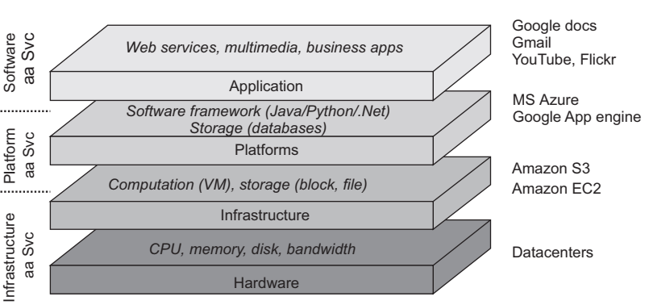
Distributed (Cloud) Computing

Slide 43
Distributed (Pervasive) Computing
Emerging next-generation of distributed systems in which nodes are small, mobile, and often embedded in a larger system, characterized by the fact that the system naturally blends into the user’s environment.
Three subtypes
Ubiquitous computing systems: pervasive and continuously present, i.e., there is a continuous interaction between system and user.
Mobile computing systems: pervasive, but emphasis is on the fact that devices are inherently mobile.
Sensor (and actuator) networks: pervasive, with emphasis on the actual (collaborative) sensing and actuation of the environment.

Slide 44
Why Use Parallel Computing?

Slide 45
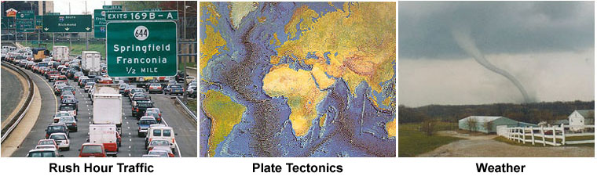
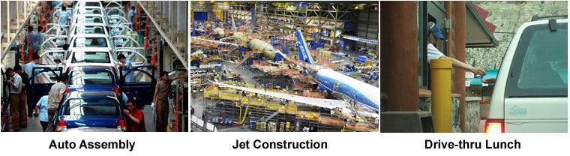
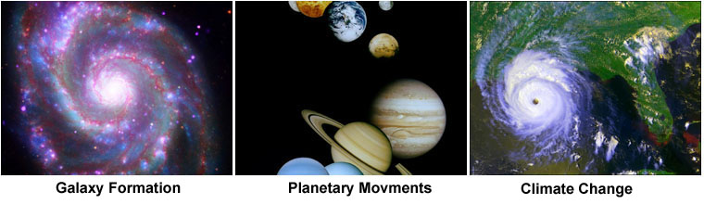
The Real World is Massively Parallel
In the natural world, many complex, interrelated events are happening at the same time, yet within a temporal sequence.
Compared to serial computing, parallel computing is much better suited for modeling, simulating and understanding complex, real world phenomena.
For example, imagine modeling these serially =>

Slide 46
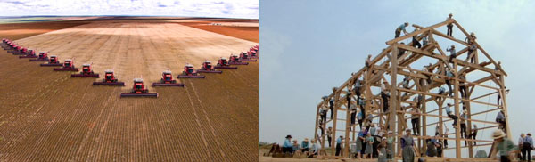
SAVE TIME AND/OR MONEY (Main Reasons)
In theory, throwing more resources at a task will shorten its time to completion, with potential cost savings.
Parallel computers can be built from cheap, commodity components.

Slide 47
SOLVE LARGER / MORE COMPLEX PROBLEMS (Main Reasons)
Many problems are so large and/or complex that it is impractical or impossible to solve them on a single computer, especially given limited computer memory.
Example: Web search engines/databases processing millions of transactions every second

Slide 48
PROVIDE CONCURRENCY (Main Reasons)
A single compute resource can only do one thing at a time. Multiple compute resources can do many things simultaneously.
Example: Collaborative Networks provide a global venue where people from around the world can meet and conduct work "virtually".

Slide 49
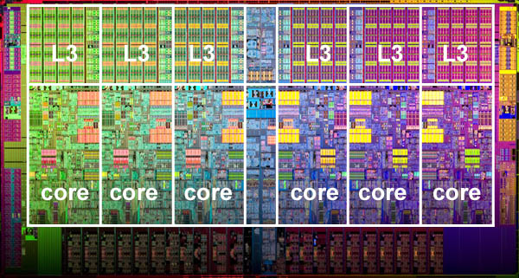
MAKE BETTER USE OF UNDERLYING PARALLEL HARDWARE (Main Reasons)
Modern computers, even laptops, are parallel in architecture with multiple processors/cores.
Parallel software is specifically intended for parallel hardware with multiple cores, threads, etc.
In most cases, serial programs run on modern computers "waste" potential computing power.
Intel Xeon processor with 6 cores and 6 L3 cache units

Slide 50
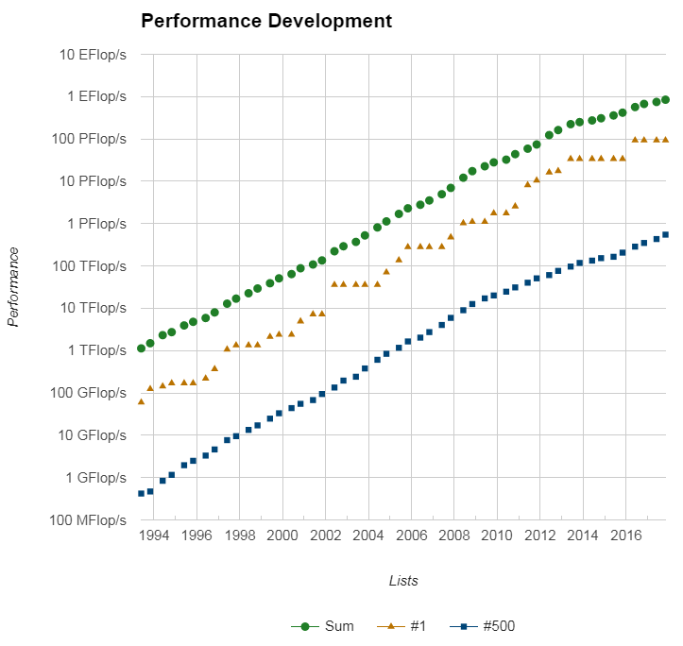
The Future (Main Reasons)
During the past 20+ years, the trends indicated by ever faster networks, distributed systems, and multi-processor computer architectures (even at the desktop level) clearly show that parallelism is the future of computing.
In this same time period, there has been a greater than 500,000x increase in supercomputer performance, with no end currently in sight.
The race is already on for Exascale Computing!
Exaflop = 10¹⁸ calculations per second

Slide 51
That’s all for today!!

